Slide 1
Risk modelling tutorial
Steffen Pauws
Philips Research
2016

Slide 2
Introduction
Clinical prediction model as risk model
Risk estimates for the presence of a disease (diagnosis)
Risk estimates for an event in the future course of disease (prognosis)
Several steps are required to develop a risk model
Formulation of the research question
What is predicted, what do we know already, what patients?
Initial data inspection
Coding of variables, predictors and outcome
Model specification
Model estimation
Evaluation of model performance
Internal validation
External validation
Model presentation
Steyerberg, E., and Vergouwe, Y. (2014) . Towards better clinical prediction models: seven steps for development and an ABCD for validation, European Heart Journal (2014) 35, 1925–1931

Slide 3
Introduction
Case study: Estimate risk of dead within one year for chronic heart failure (CHF) patients from a clinical baseline
Using logistic regression
Use of statistical learning (regression) in clinical prediction models is preferred
Risk is defined as a conditional probability
Regression can still be explained to clinicians (not-a-black-box)
Regression can be easily calibrated to another patient case-mix
Variables are predominantly additive with few interactions (which are sometimes also known)
Effects of predictors can be separated

Slide 4
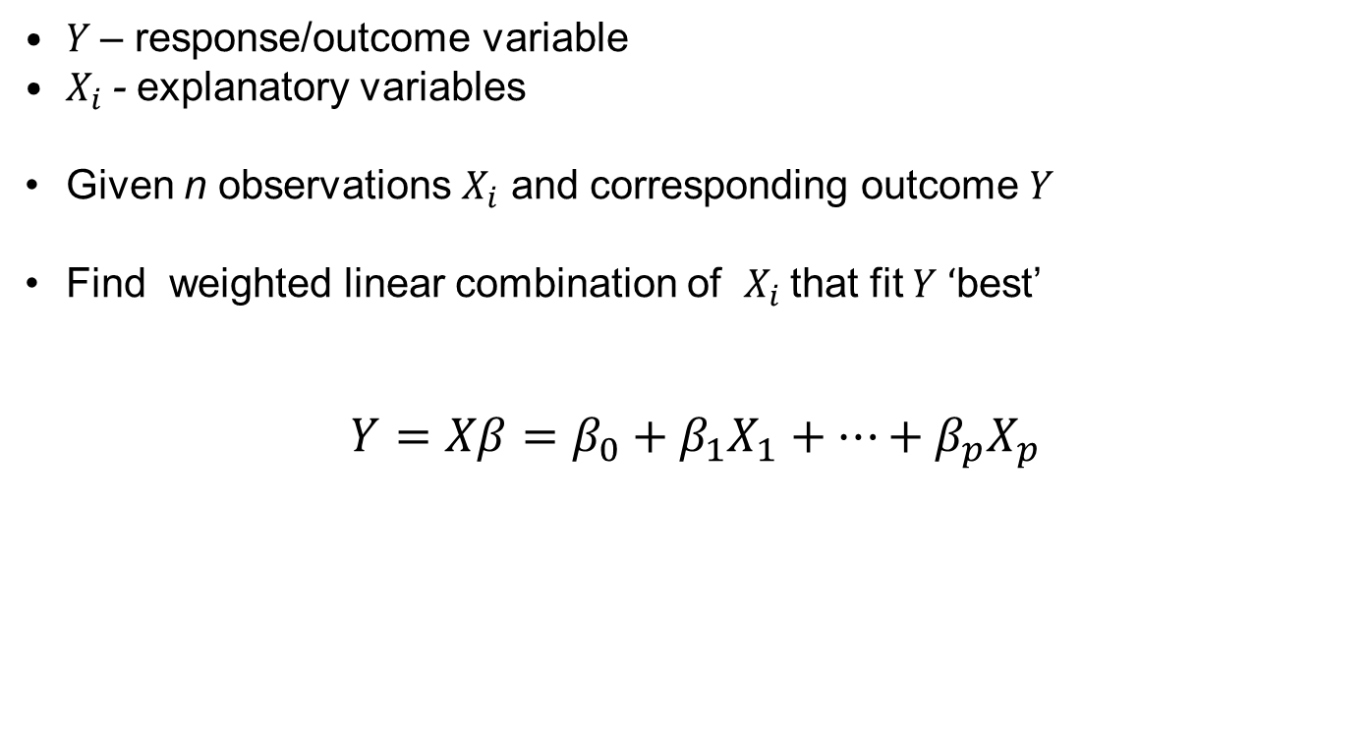
Ordinary Linear Regression
$Y$ – response/outcome variable
$X_{i}$ - explanatory variables
Given n observations $X_{i}$ and corresponding outcome $Y$
Find weighted linear combination of $X_{i}$ that fit $Y$ ‘best’
$$Y=Xβ=β_{0}+β_{1}X_{1}+⋯+β_{p}X_{p}$$

Slide 5
Ordinary Linear Regression - R code
# 15 alligators captured in Central Florida
# length – snout vent length (from back of the head to tip of the nose) in cm
# weight – grams
alligator = data.frame (
length = c (121.8, 93.9, 192.9, 78.4, 114.7, 117.0, 80.8,
109.1, 84.1, 91.1, 167.7, 111.3, 103.8, 105.9, 111.3 ),
weight = c (59112, 23091, 289873, 12672, 36213, 49871, 15020,
40831, 16271, 17278, 165578, 38070, 36213, 37691,
31799 )
)
plot(weight ~ length, data = alligator,
xlab = "Snout vent length (cm)",
ylab = "Weight (gr)",
main = "Alligators in Central Florida"
)

Slide 6
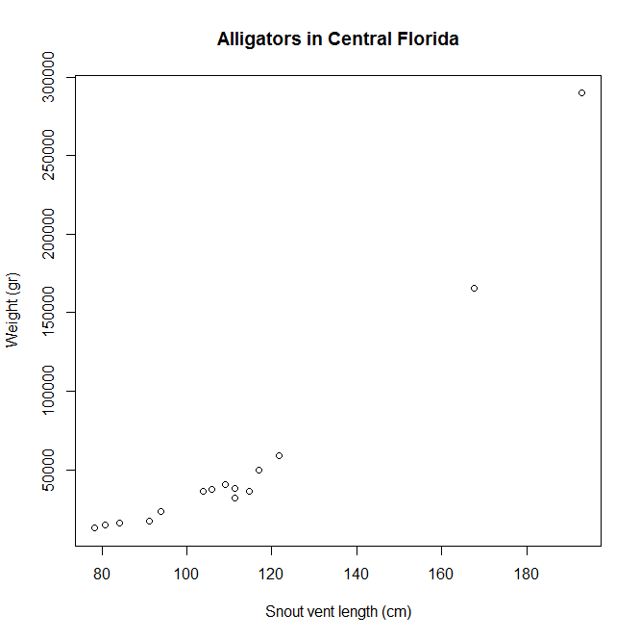

Slide 7
Ordinary Linear Regression - R code
# use (natural) log scale to enforce linearity
plot (log(weight) ~ log(length), data = alligator,
xlab = "Snout vent length (cm) in natural log scale",
ylab = "Weight (gr) in natural log scale",
main = "Alligators in Central Florida"
)

Slide 8
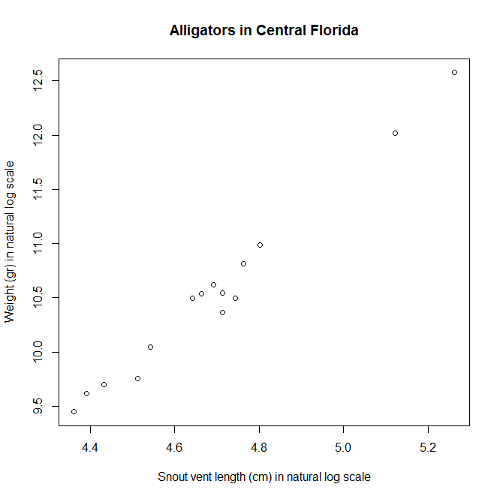

Slide 9

Ordinary Linear Regression - R code
# use ordinary linear regression with log(length) as explanatory var
# and log(weight) as response var
fit <- lm (log(weight) ~ log(length), data = alligator)
abline (fit)
summary(fit)
$$\log\left(weight\right)=−5.55+3.43∙log⁡(length)$$
intercept $β_{0}=−5.55 (p<.001);$
slope $β_{1}=3.43 (p<.001);$

Slide 10
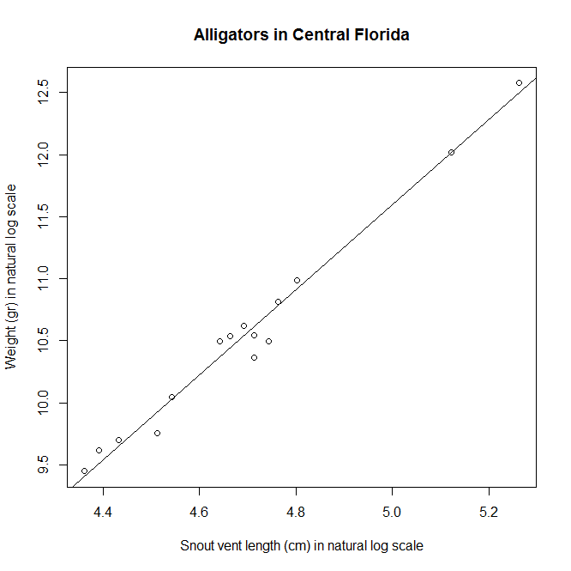

Slide 11
Ordinary Linear Regression - R code
> summary(fit)
Call:
lm(formula = log(weight) ~ log(length), data = alligator)
Residuals:
Min 1Q Median 3Q Max
-0.24358 -0.03167 0.03833 0.07748 0.12571
Coefficients:
Estimate Std. Error t value Pr(>|t|)
(Intercept) -5.5530 0.6239 -8.901 6.83e-07 ***
log(length) 3.4302 0.1328 25.821 1.48e-12 ***
---
Signif. codes: 0 ‘***’ 0.001 ‘**’ 0.01 ‘*’ 0.05 ‘.’ 0.1 ‘ ’ 1
Residual standard error: 0.1229 on 13 degrees of freedom
Multiple R-squared: 0.9809, Adjusted R-squared: 0.9794
F-statistic: 666.7 on 1 and 13 DF, p-value: 1.482e-12

Slide 12
Ordinary Linear Regression - R code
What’s wrong with the normal distribution of the residuals
plot(resid(fit) ~ fitted(fit),
xlab = "Fitted Values",
ylab = "Residuals",
main = "Residual Diagnostic Plot",
ylim = c (-0.5, 0.5)
)
grid()
abline(0.0)
qqmath( ~ resid(fit),
xlab = "Theoretical Quantiles",
ylab = "Residuals"
)

Slide 13
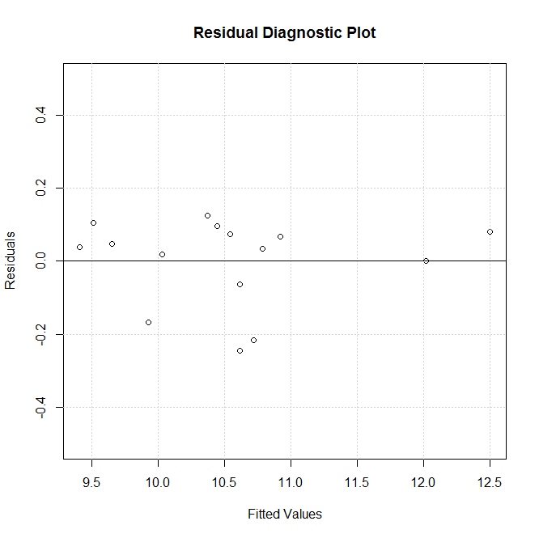
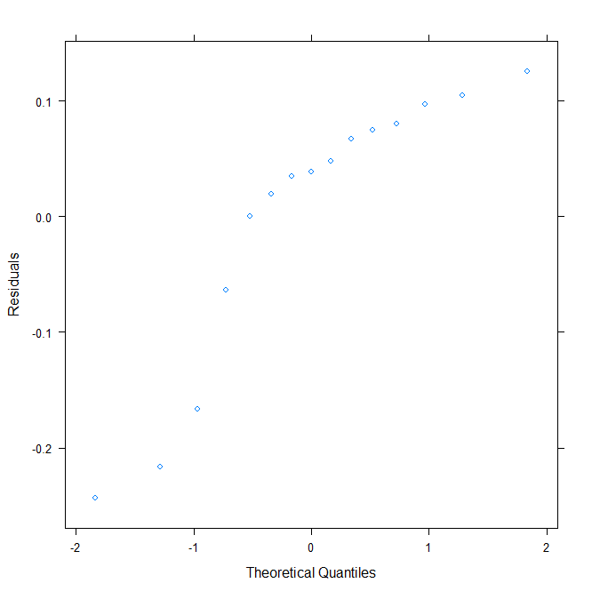

Slide 14
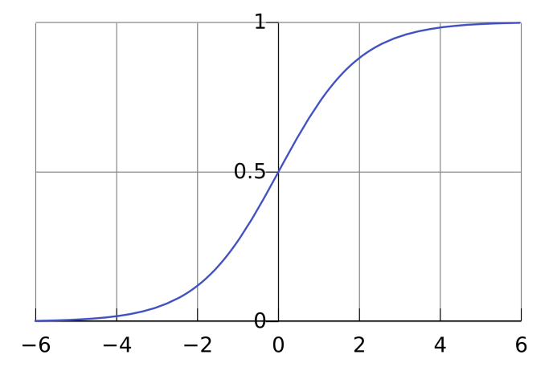




Logistic regression
Logistic regression is a statistical technique to predict binary prognostic outcome, such as dead, morbidity or hospitalization
Binary outcome of dead within one year, denoted as “Y=1”, is linked to a linear combination of predictors, denoted as “$X_{i}$”, that are weighted by (regression) coefficients $β_{i}$. This is written as $Xβ=β_{0}+β_{1}X_{1}+⋯+β_{p}X_{p}$.
However, not the outcome dead is estimated directly, rather the probability of its occurrence, given X, “$P(Y=1|X)$” is modeled.
$$P\left(Y=1 | X\right)={(1+exp\left(−Xβ\right))}^{−1}$$
$$P(Y=1|X)$$
logistic function
$$Xβ→$$

Slide 15
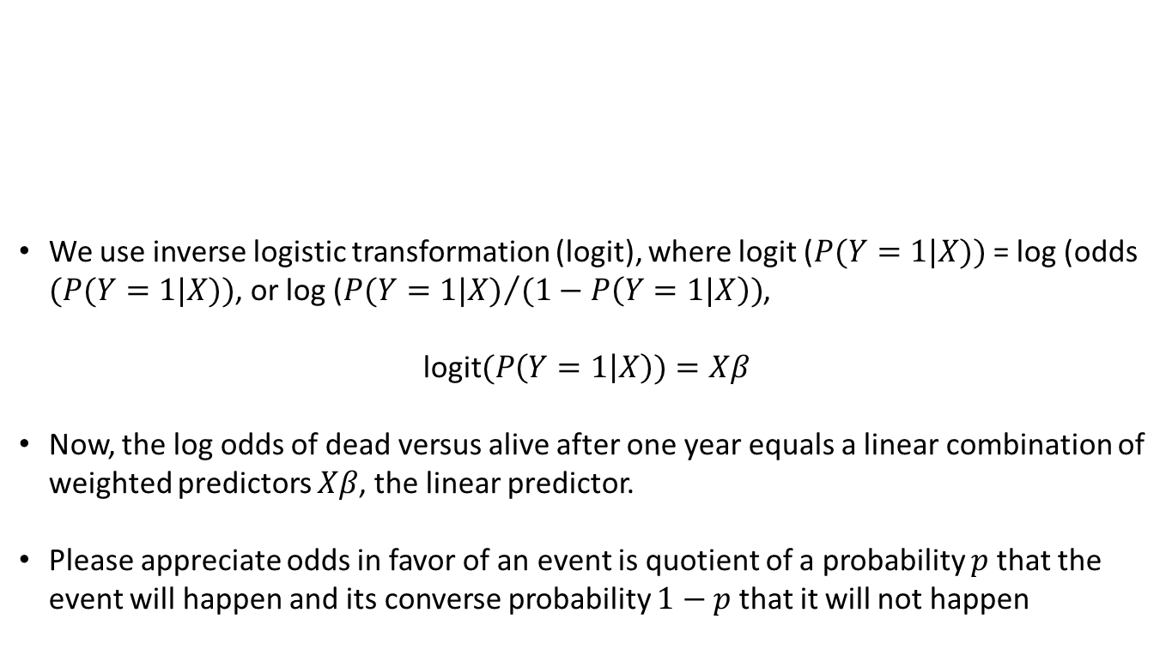
Logistic regression
$$P(Y=1|X)$$
We use inverse logistic transformation (logit), where logit ($P(Y=1|X))$ = log (odds $(P(Y=1|X))$, or log (${P(Y=1|X)}/{(1−P\left(Y=1|X\right))}$,
$$\text{logit}(P\left(Y=1 | X\right))=Xβ$$
Now, the log odds of dead versus alive after one year equals a linear combination of weighted predictors $Xβ$, the linear predictor.
Please appreciate odds in favor of an event is quotient of a probability $p$ that the event will happen and its converse probability $1−p$ that it will not happen
$$Xβ→$$

Slide 16
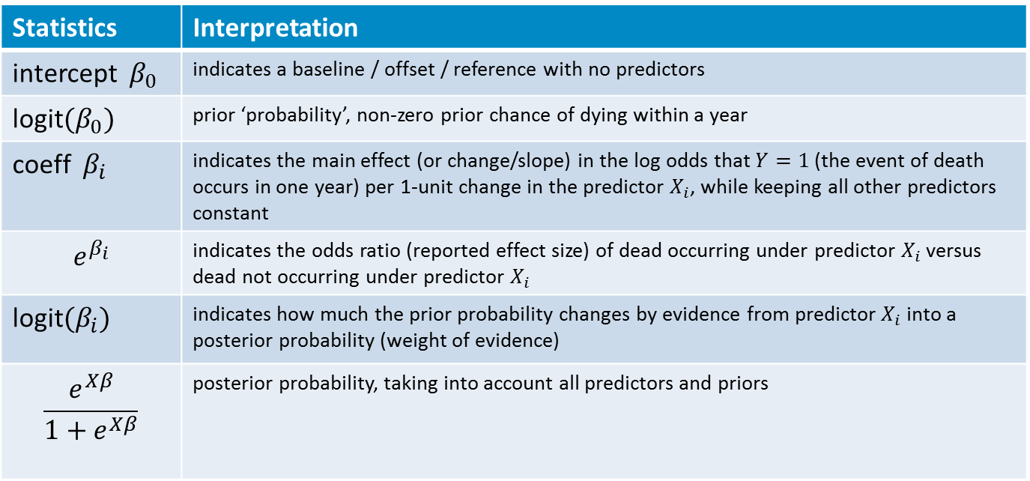
Logistic regression
Statistics | Interpretation
intercept $β_{0}$ | indicates a baseline / offset / reference with no predictors
$\text{logit}(β_{0})$ | prior ‘probability’, non-zero prior chance of dying within a year
coeff $β_{i}$ | indicates the main effect (or change/slope) in the log odds that $Y=1$ (the event of death occurs in one year) per 1-unit change in the predictor $X_{i}$, while keeping all other predictors constant
$$e^{β_{i}}$$ | indicates the odds ratio (reported effect size) of dead occurring under predictor $X_{i}$ versus dead not occurring under predictor $X_{i}$
$\text{logit}(β_{i})$ | indicates how much the prior probability changes by evidence from predictor $X_{i}$ into a posterior probability (weight of evidence)
$$\frac{e^{Xβ}}{1+e^{Xβ}}$$ | posterior probability, taking into account all predictors and priors

Slide 17
Logistic regression – R example
bloodtest.R
bloodvalue <- c (0, 2:37, 40)
dead <- c (0,0,0,0,0,0,0,0,0,0,0,0,0,0,0,0,1,1,0,
0,1,1,0,1,1,1,0,1,1,1,1,1,1,1,1,1,1,0)
bloodtest <- vector()
for (i in c(1:length(bloodvalue))) {
bloodtest[i] <- if (bloodvalue[i] > 20) 1 else 0 }
plot (dead ~ sort (bloodvalue), xlab = "blood value",
ylab = "1-Y dead", type = "p" )
# fit an ordinary linear regression: does not work
fit <- lm (dead ~ bloodvalue)
coefficients(fit)
abline(fit)
# fit a logistic regression on predictor blood test
fit <- glm (factor(dead) ~ bloodtest, family=binomial)
Coefficients ( fit )
exp ( coefficients ( fit ) )
lines (sort(bloodvalue), fit$fitted, type="l", col=“red")
table (bloodtest, dead)

Slide 18
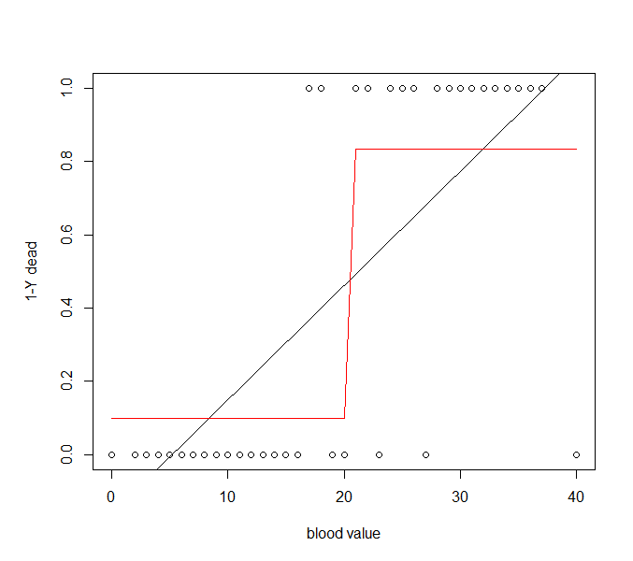
Cut-off for dichotomizing blood test: blood value > 20
Negative blood test
Positive blood test

Slide 19
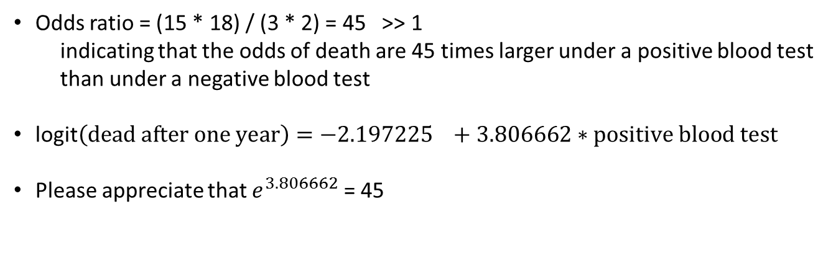
Logistic regression – R example
bloodtest.R
 | Dead (one year) | Survived (one year)
Positive blood test (blood value > 20) | 15 | 3 | 18
Negative blood test (blood value <= 20) | 2 | 18 | 20
 | 17 | 21 | 38
Odds ratio = (15 * 18) / (3 * 2) = 45 >> 1
indicating that the odds of death are 45 times larger under a positive blood test than under a negative blood test
$\text{logit}\left(dead after one year\right)=−2.197225 +3.806662∗positive blood test$
Please appreciate that $e^{3.806662}$ = 45

Slide 20
Exercise of today
Estimate risk of dead within one year for chronic heart failure (CHF) patients from a clinical baseline
Risk = probability of the occurrence of an event within a pre-defined follow-up time
Use logistic regression
Binary outcome: 1Y-dead
Predictors: demographics, vital signs, lab values (blood markers), self-reported QoL
Moment: baseline (e.g., at discharge after acute HF episode)
Data set used:
An ETL merge of CHF patients
Outpatient clinic in Hull
TEN-HMS RCT
HartMotief RCT
7,488 patients (5870, 75% survived / 1618, 22% died within one year)
7077 (95%) on usual care – 411 (5%) on telehealth

Slide 21
Excerpt from CSV file
Case,Source,ID,Country,Date,Year,Gender,Motiva,Dead,Alive,Age,Height,Weight,SysBP,DiaBP,Pulse,NTproBNP,Creatinine,Hemoglobin,Glucose,QoL
1,TENHMS,DE.101,DE,11-07-2000,2000,0,0,1,0,61,175,68,90,58, , , ,13, ,3
2,TENHMS,DE.102,DE,02-08-2000,2000,0,0,0,1,85,165,67,110,70, , , ,14.7, ,3
3,TENHMS,DE.103,DE,02-08-2000,2000,0,0,0,1,75,180,81,122,78, , , ,10.9, ,2
4,TENHMS,DE.104,DE,31-08-2000,2000,0,1,0,1,56,178,90,112,68, , , ,13.9, ,5
5,TENHMS,DE.105,DE,29-08-2000,2000,0,1,0,1,69,174,88,100,75, , , ,15.5, ,1
6,TENHMS,DE.106,DE,20-09-2000,2000,0,0,0,1,54,160,68,100,70, ,279.7,1,13.9, ,2
…
…
414,Hull,65,GB,17-08-2009,2009,0,0,0,1,76.67077344, , , , , , ,1.2, ,4.8,
415,Hull,66,GB,05-06-2000,2000,1,0,1,0,79.4715948, , , , , , ,1.2,11.1, ,
416,Hull,67,GB,27-03-2007,2007,0,0,1,0,76.76659822,176,70.4,110,65,82,1530.7,1.1,11.6,5.3,4
417,Hull,68,GB,02-02-2010,2010,1,0,0,1,77.23750856,167,64.1,110,60,92,3137.5,1.3,13.3,4.4,4
…
…
7485,HartMotief,18-043,NL,14-06-2006,2006,1,0,0,1,64.1615332,163,93,0,0,60,525.4,.8,13.2, ,
7486,HartMotief,18-044,NL,12-06-2006,2006,0,0,0,1,72.88706366,170,70,110,70,64,720.3,1.2,15, ,
7487,HartMotief,18-045,NL,11-07-2006,2006,0,0,0,1,48.14236824,178,75,100,60,68,500,.9,15.1, ,
7488,HartMotief,18-046,NL,19-06-2006,2006,0,1,0,1,45.908282,176,104,110,70,88,43.2,.9,14.5, ,

Slide 22

Variable name | Description | Scale | Unit
Case | Case number | nominal | n.a.
Source | Data source: TENHMS, Hull, HartMotief | nominal | n.a.
ID | De-identified unique patient number | nominal | n.a.
Country | Country of patient: DE, GB, NL | nominal | n.a.
Date | Date of measurement (entry, enrollment) | date | n.a.
Dead | Specifies whether patient had died after one year follow-up | binary | n.a.
Alive | Specified whether patient had survived (was still alive) after one year follow-up | binary | n.a.
Year | Year of measurement | ordinal | n.a.
Gender | Gender of patient | binary | n.a.
Motiva | Specifies whether patient received telehealth (e.g., Motiva) or only standard care | binary | n.a.
Age | Age of patient at baseline | ordinal | years
Height | Height of patient at baseline | interval | cm
Weight | Weight of patient at baseline | interval | kilograms
SysBP | Measured systolic blood pressure of patient at rest | interval | mmHg
DiaBP | Measured diastolic blood pressure of patient at rest | interval | mmHg
Pulse | Measured heart rate / pulse of patient at rest and at baseline. | ratio | bpm
NTproBNP | Measured level of NT-proBNP in blood serum at baseline. The higher its level, the more severe CHF | ratio | pg/mL
Creatinine | Measured level of creatinine in blood serum at baseline. If the filtering of the kidney is deficient, creatinine level in blood rises | ratio | mg/dL
Hemoglobin | Measured level of hemoglobin in blood serum at baseline. A low hemoglobin level is referred to as anemia. | ratio | g/dL
Glucose | Measured level of glucose in blood serum at baseline (by a fasting blood glucose test). Diabetes mellitus is characterized by persistently high blood glucose level | ratio | mmol/L
QoL | Score on a standardized quality of life survey (EuroQOL) at baseline | 7-point ordinal | 0-6 (least – most favorable)

Slide 23
Steps for building risk model
Approval from data owners/ICBE and informed patient consent
De-identification and data share
Data preparation and pre-processing
Outlier analysis
Missing value analysis
Imputation (or ignorance)
Modeling – Univariate
Modeling – Multivariate
Testing & validation
Clinical (external) validation
Transfer

Slide 24
Reading the data
library (Hmisc, T) # Harrell’s miscellaneous library with functions useful for data analysis
library (rms) # accompanies Harrell's book Regression Modeling Strategies
library (graphics)
library (lattice)
# load the data set
filename = "C:/My Projects/0 Population Health/Shanghai/lectures/riskmodel/R/baseline.csv"
mydata <- read.csv(filename)
# tell R that some vars are nominal, ordinal factors
mydata$Dead.f <- factor (mydata$Dead, exclude = NULL, ordered = FALSE)
a <- factor(mydata$Gender)
mydata$Gender <- factor(a, levels = c(0,1), labels =c("female","male"))
mydata$Source <- factor (mydata$Source, exclude = NULL, ordered = FALSE)
mydata$Country <- factor (mydata$Country, exclude = NULL, ordered = FALSE)
mydata$Motiva <- factor (mydata$Motiva, exclude = NULL, ordered = FALSE)
levels(mydata$Motiva) <- c("usual care", "telehealth")
mydata$QoL <- factor (mydata$QoL , ordered = TRUE)
# add BMI to the set
mydata$BMI <- mydata$Weight / ( 0.0001 * mydata$Height * mydata$Height)
# list of names of variables to analyse
vars <- c ( "Dead", "Gender", "Age", "Motiva", "Height", "Weight", "SysBP", "DiaBP", "Pulse", "NTproBNP", "Creatinine", "Hemoglobin", "Glucose", "QoL" )
summary (mydata[,vars])
describe(mydata[,vars])

Slide 25
Outlier analysis
get to know the data via summaries of descriptive statistics and visualizations of distributions, histograms and scatterplot, etc.,
outliers are values that are extreme or numerically distant from other values in the sample without a plausible explanation
bias predictive (risk) modeling
exhibit a large influence on regression parameters.
Removal of outliers, by e.g.,
treating them as a missing value
truncating them (cut-off)
(single) imputing them with different values (mean, median, random from distribution)

Slide 26
R code
# plot a scatterplot on sorted values, histogram or a density
# and a boxplot on dead, gender, QoL, age, height
par (mfrow = c(3,3))
plot (sort (mydata$Dead.f), pch = ".", ylab="Frequency", xlab="1Y-dead" )
plot (sort (mydata$Gender), pch = ".", ylab="Frequency", xlab="gender" )
plot (sort (mydata$QoL) , pch = ".", ylab="Frequency", xlab="QoL score" )
plot ( sort (mydata$Age), pch = ".", ylab="age(yrs)", xlab="sorted case" )
plot (density(mydata$Age, na.rm=TRUE), xlab="age(yrs)", main="age")
boxplot ( mydata$Age ~ mydata$Dead, data = mydata, xlab="1Y-dead", ylab="age(yrs)", main="" )
plot (sort (mydata$Height), pch = ".", ylab="height(cm)", xlab="sorted case" )
plot (density(mydata$Height, na.rm=TRUE), xlab="height(cm)", main="weight")
boxplot ( mydata$Height ~ mydata$Dead, data = mydata, xlab="1Y-dead", ylab="height(cm)", main="" )
# ..and the corresponding descriptive statistics
vars <- c( "Dead", "Gender", "QoL", "Age", "Height" )
summary (mydata[,vars])

Slide 27
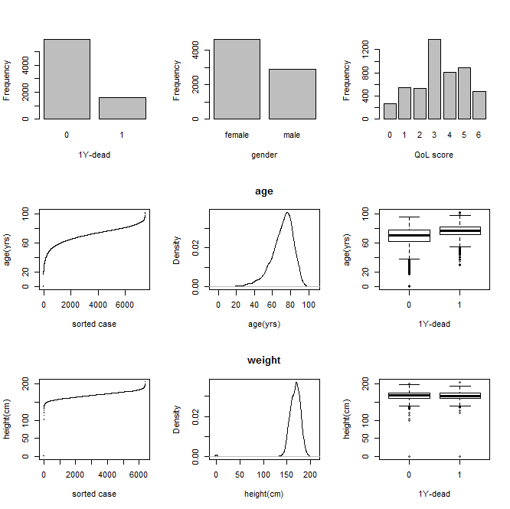

Slide 28
R code
# plot a scatterplot on sorted values, histogram or a density
# and a boxplot compared w/ outcome for weight, HR and SBP
par (mfrow = c(3,3))
plot (sort(mydata$Weight), pch = ".", ylab="weight(gr)", xlab="sorted case")
plot (density(mydata$Weight, na.rm=TRUE), xlab="weight(gr)", main="height")
boxplot ( mydata$Weight ~ mydata$Dead, data = mydata, xlab="1Y-dead", ylab="weight(gr)", main="" )
plot (sort (mydata$Pulse), pch = ".", ylab="HR(bpm)", xlab="sorted case" )
plot (density(mydata$Pulse, na.rm=TRUE), xlab="HR(bpm)", main="HR")
boxplot ( mydata$Pulse ~ mydata$Dead, data = mydata, xlab="1Y-dead", ylab="HR(bpm)", main="" )
plot (sort(mydata$SysBP), pch = ".", ylab="SBP(mmHg)", xlab="sorted case" )
plot (density(mydata$SysBP, na.rm=TRUE), xlab="SBP(mmHg)", main="SBP")
boxplot ( mydata$SysBP ~ mydata$Dead, data = mydata, xlab="1Y-dead", ylab="SBP(mmHg)", main="" )
# ..and the corresponding descriptive statistics
vars <- c( "Weight", "Pulse", "SysBP" )
summary (mydata[,vars])

Slide 29
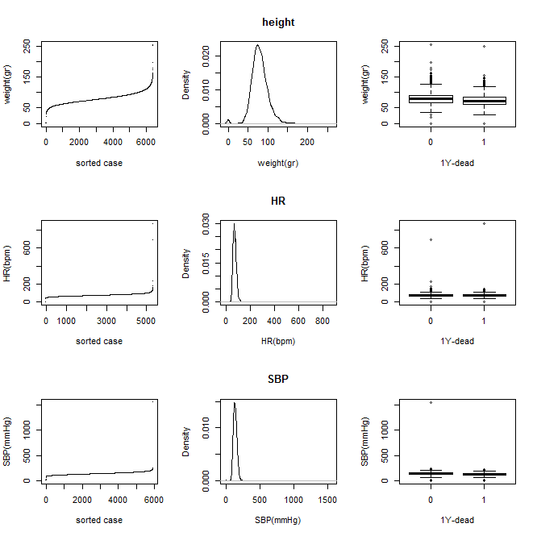

Slide 30
R code
# plot a scatterplot on sorted values, histogram and a density
# and a boxplot compared w/ outcome for NTproBNP, Cr, glucose, Hgb
par (mfrow = c(4,3))
plot (sort(log10(mydata$NTproBNP)), pch = ".", ylab="NT-proBNP(log pg/mL)", xlab="sorted case")
plot (density(log10(mydata$NTproBNP), na.rm=TRUE), xlab="NT-proBNP(log pg/mL)", main="NT-proBNP")
boxplot ( log10(mydata$NTproBNP) ~ mydata$Dead , data = mydata, xlab="1Y-dead", ylab="NT-proBNP(log pg/mL)", main="" )
plot (sort (mydata$Creatinine), pch = ".", ylab="Cr(log mg/dL)", xlab="sorted case" )
plot (density(mydata$Creatinine, na.rm=TRUE), xlab="Cr(log mg/dL)", main="Creatinine")
boxplot ( mydata$Creatinine ~ mydata$Dead, data = mydata, xlab="1Y-dead", ylab="Cr(log mg/dL)", main="" )
plot (sort (mydata$Glucose), pch = ".", ylab="glucose(log mmol/L)", xlab="sorted case" )
plot (density(mydata$Glucose, na.rm=TRUE), xlab="glucose(log mmol/L)", main="Glucose")
boxplot ( mydata$Glucose ~ mydata$Dead, data = mydata, xlab="1Y-dead", ylab="glucose(log mmol/L)", main="" )
plot (sort (mydata$Hemoglobin), pch = ".", ylab="Hgb(log g/dL)", xlab="sorted case" )
plot (density(mydata$Hemoglobin, na.rm=TRUE), xlab="Hgb(log g/dL)", main="Hemoglobin")
boxplot ( mydata$Hemoglobin ~ mydata$Dead, data = mydata, xlab="1Y-dead", ylab="Hgb(log g/dL)", main="" )
# ..and the corresponding descriptive statistics
vars <- c( "NTproBNP", "Creatinine", "Glucose", "Hemoglobin" )
summary (mydata[,vars])

Slide 31
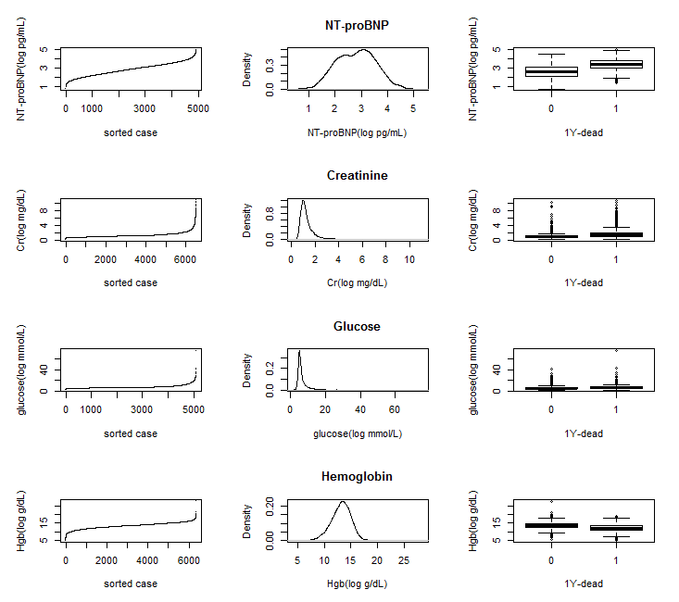

Slide 32
Outliers for age
Zero and one-year age: three babies in the dataset?
Two patients older than 100 years -> OK
Consider low age missing and simple-impute them with median value
# for age, getting min max, range and indices
range(mydata$Age, na.rm = TRUE)
min(mydata$Age, na.rm = TRUE)
max(mydata$Age, na.rm = TRUE)
which.min(mydata$Age)
which.max(mydata$Age)
# which patients are 'non-adults' or 'antique' and what is their age
idx <- which (mydata$Age < 21 | mydata$Age >= 100)
idx
sort ( mydata$Age[idx])
# consider zero and one year of age as a missing value or simple impute them
idx <- which (mydata$Age == 0 | mydata$Age == 1)
mydata$Age[idx] <- NA
or
mydata$Age[idx] <- median(mydata$Age, na.rm=TRUE)

Slide 33
Outliers for weight and height
20 cases with reported weights of zero
20 cases with zero height one tall person of 2m5cm
Consider them missing or simple-impute them with median value
# find patients below 10 kilograms, which all happen to be zero-weight
idx <- which (mydata$Weight < 10)
idx
mydata$Weight[idx]
# consider missing or impute them with median weight
idx <- which (mydata$Weight == 0)
mydata$Weight[idx] <- NA
mydata$Weight[idx] <- median(mydata$Weight, na.rm=TRUE)
# find short people shorter than 1 m and tall people longer than 2 m
idx <- which (mydata$Height < 100 | mydata$Height > 200)
idx
mydata$Height[idx]
# consider missing or impute them with median height
idx <- which (mydata$Height == 0)
mydata$Height[idx] <- NA
mydata$Height[idx] <- median(mydata$Height, na.rm=TRUE)

Slide 34
Outliers for SysBP, DiaBP, Pulse (HR)
SysBP
9 cases with zero SysBP values. People with zero blood pressure are dead people
5 cases below 18 mmHg SysBP
one case of 1,554 mmHg SysBP, whereas an exceptionally high systolic blood pressure ‘at rest’ would be already in the range of 200 to 250 mmHg.
DiaBP
13 cases with implausible low values (below 8 mmHg) including even one case with a negative value (-80 mmHg), and 10 zero-cases
Pulse (HR)
5 cases with no or nearly no pulse (< 10 bpm)
3 cases with an exceptionally high pulse (>220 bpm) .
All outliers were imputed by their median value

Slide 35
Outliers for blood markers
For NT-proBNP, one exceptionally high value: 102,474.6 pg/mL (case #151)
For creatinine, we discover no spurious values; they are all in an acceptable range (from 0.3 to 11 mg/dL) including patients with severe kidney failure.
For hemoglobin, we discover no spurious values. Hgb levels below 11 g/dL are indicative for anemia. Almost all measurements are within an acceptance range (4.5 g/dL to 20 g/dL). There are three extreme values (> 20 mg/dL).
5 cases with extreme glucose values (above 30 mmol/L)
No action taken

Slide 36
Missing value analysis
Find out the possible cause of missing values!
Missing completely at random (MCAR) due to administrative errors or unfortunate incidents during measurement or collection. A missing value is unrelated to any patient/center characteristics or outcome, were the value to be known.
Missing at random (MAR) due to patient characteristics, time, place or outcome. The probability of a missing value depends on values of other variables. For instance, a patient is too sick to perform a test, which may result in missing values for the test at high severity of the disease.
Missing not at random (MCAR) or informative missing (IM), due to the value of the variable itself, the hospital data collection protocol or the de-identification procedure. For instance, a hospital may not order particular blood tests. This kind of missing is hard to resolve

Slide 37
Missing value analysis
Investigate the following
the frequency of missing values for each variable
the relation of missing values for one variable with values of other variables
the relation of missing values for one variable with the outcome
the relation of missing values for one variable with auxiliary variables (or subject matter knowledge).
Start with Cleveland dot charts
# A frequency dot plot for NAs
result <- sapply(mydata, function(x)sum(is.na(x)))
dotplot (sort(result), main="Number of missing values", xlab = "Frequency")
# A proportional dot plot for NAs
num <- dim(mydata)[1]
result <- sapply (mydata, function(x) sum(is.na(x)) / num)
dotplot (sort (result), main="Proportion of missing values", xlab = "Proportion" )

Slide 38
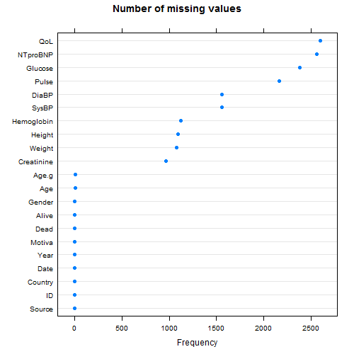
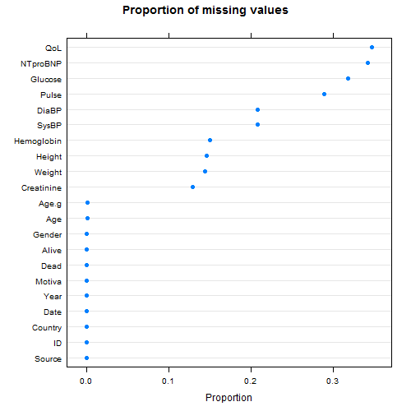

Slide 39
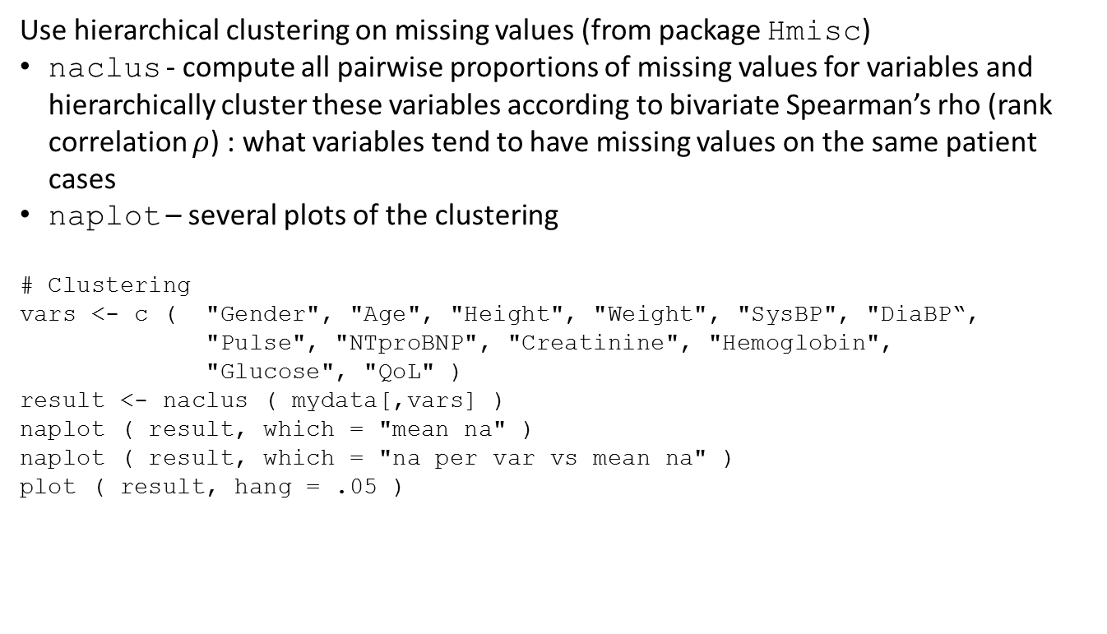
Missing value analysis
Use hierarchical clustering on missing values (from package Hmisc)
naclus - compute all pairwise proportions of missing values for variables and hierarchically cluster these variables according to bivariate Spearman’s rho (rank correlation $ρ$) : what variables tend to have missing values on the same patient cases
naplot – several plots of the clustering
# Clustering
vars <- c ( "Gender", "Age", "Height", "Weight", "SysBP", "DiaBP“,
"Pulse", "NTproBNP", "Creatinine", "Hemoglobin",
"Glucose", "QoL" )
result <- naclus ( mydata[,vars] )
naplot ( result, which = "mean na" )
naplot ( result, which = "na per var vs mean na" )
plot ( result, hang = .05 )
Notes:
The Hmisc package includes two functions for missing value analysis: naclus and naplot. They display what variables tend to have missing values on the same patient cases. With naclus, we can compute all pairwise proportions of missing values for variables and hierarchically cluster these variables according to a similarity measure. It uses bivariate Spearman’s rho (rank correlation $ρ$) which assesses the level of monotonicity between two (ordinal) variables. In case of missing value analysis, this comes down to the proportion of missing values in common between any two variables. Thus, naclus tells us which variables tend to have missing values on the same patients and computes the proportion of missing value per variable. naclus returns a matrix of pairwise proportions which can be plotted. The diagonals of this matrix reflect the proportion of missing values for each variable itself. naplot can generate four different cluster plots based on this similarity matrix, similar to the dot charts above. We will display a dot chart showing mean number of other variables missing when the indicated variable is missing and a scatterplot showing on the x-axis the proportion of missing values in the variable and on the y-axis the mean number of other variables that are missing when the indicated variable has a missing value. A simple plot of the similarity matrix results into the graphical representation of the result of the hierarchical clustering, in which we can identify the co-occurrence of missing values across variables.

Slide 40
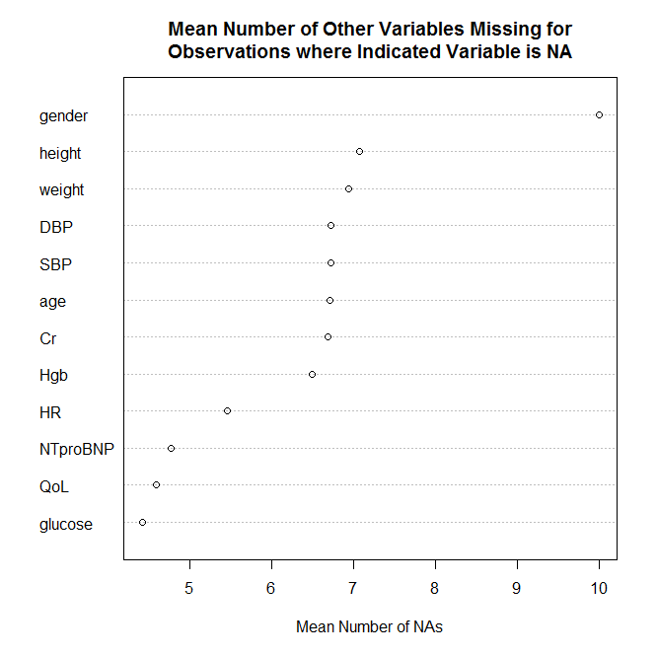

Slide 41
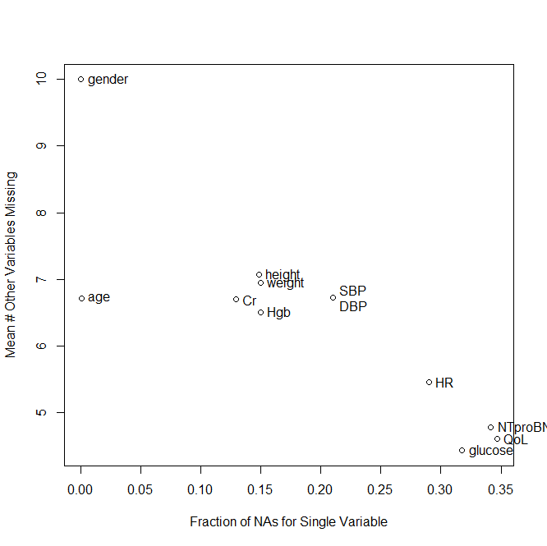

Slide 42
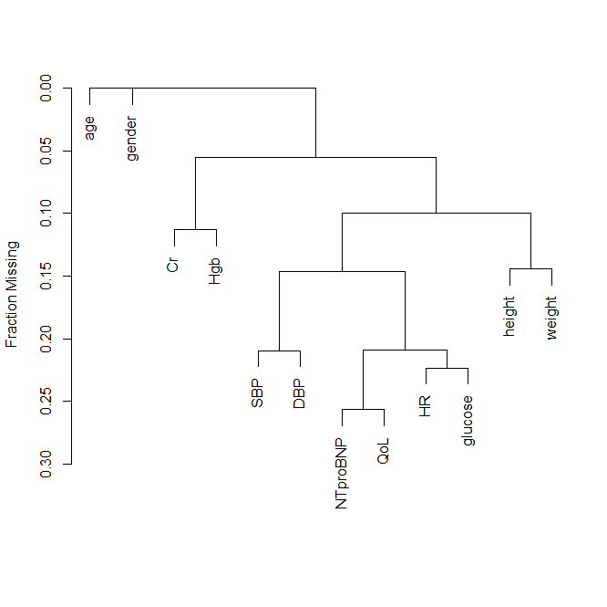

Slide 43
Missing value analysis
The hierarchical clustering reveals that the pairs
NTproBNP and QoL
SysBP and DiaBP
Pulse (HR) and Glucose
Height and Weight
Creatinine (Cr) and Hemoglobin (Hgb)
happen to have missing values at the same patient cases. These pairs cannot be used to impute each other’s missing value.

Slide 44
Missing value analysis
Other techniques to reveal why data are missing
Recursive partitioning – decision tree on missingness of values for variables using auxiliary variables and other variables. For example for NT-proBNP
result <- rpart ( is.na ( NTproBNP ) ~ Source + Country + Age + Gender +
Motiva + Dead + is.na(QoL), data = mydata )
plot ( result )
text ( result, cex = 0.75 )

Slide 45
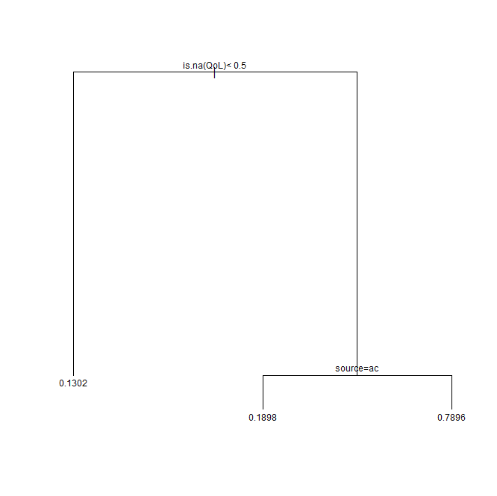
Almost 80% of missing values for NTproBNP co-occurs with an absent QoL at the Hull outpatient clinic.

Slide 46
Missing value analysis
Yet another technique
dot-plot simple descriptive statistics on the proportion of missing values for a variable, stratified by all available variables. For example, NT-proBNP.
result <- summary ( is.na (NTproBNP ) ~ Source + Country + Age + Gender + Motiva + Dead, data = mydata)
plot (result, cex.lab = 0.75, xlab="Missing value for NT-proBNP", main ="Missing NT-proBNP stratified for demographics and outcome", sub="" )
result <- summary ( is.na (NTproBNP ) ~ SysBP + Pulse + Weight + Height + QoL, data = mydata)
plot (result, cex.lab = 0.75, xlab="Missing value for NT-proBNP", main ="Missing NT-proBNP stratified for measurements and self-reports", sub="")

Slide 47
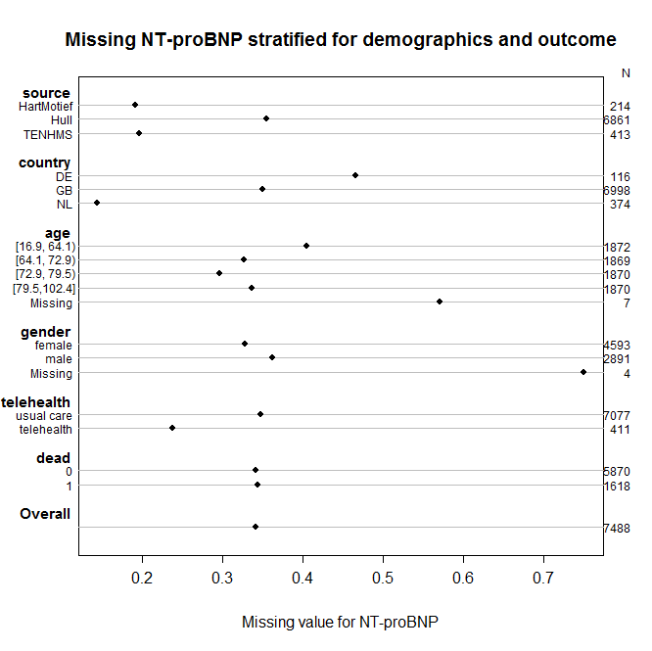

Slide 48
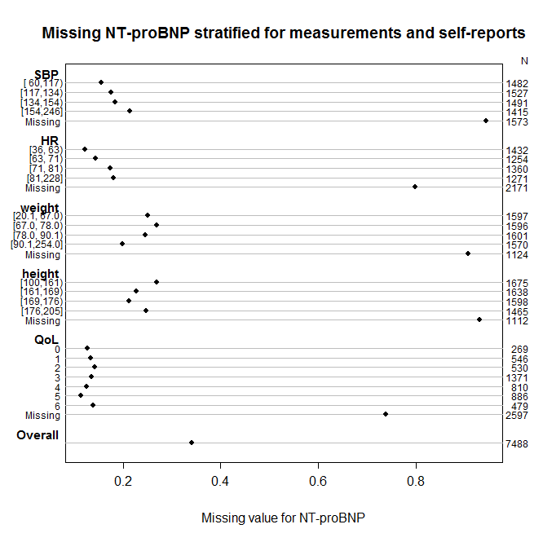

Slide 49
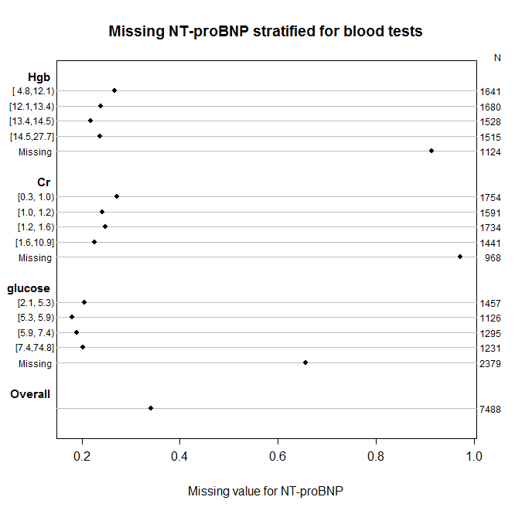

Slide 50
Missing value analysis
NTproBNP not measured in about 19% of cases in HartMotief and TEN-HMS studies and 36% in outpatient clinic cases
No different proportions in missing for outcome (dead)
Lacking evidence in cause-telling of missing NT-proBNP values
Were some hospitals participating in the HartMotief and TEN-HMS studies unable to measure NT-proBNP??

Slide 51
Imputation (or ignorance)
How to deal with missing values:
Complete case (CC) analysis ignores cases with any missing predictor values. All cases with a missing value for any potential predictor are excluded;
Available case analysis consider cases with complete data for one predictor, who may have missing values for other predictors;
Simple imputation substitute a missing value of a continuous predictor with the mean or most frequent category for a categorical predictor;
Single imputation creates a complete data set by substituting missing values of a predictor by using a model using data from the other predictors;
Multiple imputation creates multiple independent complete data sets by substituting missing values by using single imputation techniques.

Slide 52
Imputation (or ignorance)
Rules of thumbs when it comes to dealing with missing values
Proportion of missing values < 5%. Simple imputation method will do. Continuous predictor use median for missing value. For nominal predictor use most frequently category. CC analysis is optional.
Proportion of missing values 5 – 15%. If predictor is uncorrelated with others, use simple imputation. If predictors is correlated, use model-based single imputation
Proportion of missing values > 15%. Use model-based multiple imputation.
Outcome is missing. Oops! There are studies in which they impute outcome. Try use censoring.

Slide 53
Imputation (or ignorance)
Some R packages for imputation are the following
transcan and impute function in Hmisc for single and multiple imputation
aregImpute function in Hmisc for advanced multiple imputation
mice: Multivariate Imputation by Chained Equations (see http://www.multiple-imputation.com/)
amelia package (see http://gking.harvard.edu/amelia/)
Data imputation is a field on its own
Too complex to tell in a single lecture
Data imputation does not necessarily lead to better risk models

Slide 54
Imputation (or ignorance)
A complete case (CC) analysis of our data set will exclude 3,843 cases out of a total of 7,488, which is 51%.
# what number of cases is excluded in CC analysis
vars <- c ("Gender", "Age", "Motiva", "Height", "Weight", "SysBP", "Pulse", "NTproBNP",
"Creatinine", "Hemoglobin", "Glucose", "QoL" )
idx <- which( rowSums(is.na(mydata[,vars])) > 0)
length(idx)
length (idx) / nrow (mydata)
Plot cumulative proportion of complete cases over no. missing values per case
# what is the cumulative data set size over no. missing values per case
vars <- c ("Gender", "Age", "Motiva", "Height", "Weight", "SysBP", "Pulse", "NTproBNP",
"Creatinine", "Hemoglobin", "Glucose", "QoL" )
CC <- c()
for (m in c(1:(length(vars)+1))) {
idx <- which( rowSums(is.na(mydata[,vars])) < m)
CC[m] <- length (idx) / nrow (mydata)
}
plot( c(0:length(vars)), CC*100.0, xlab="no. missing values per case",
ylab="cumulative data set size (%)", type = "b" )
CC*100.0

Slide 55
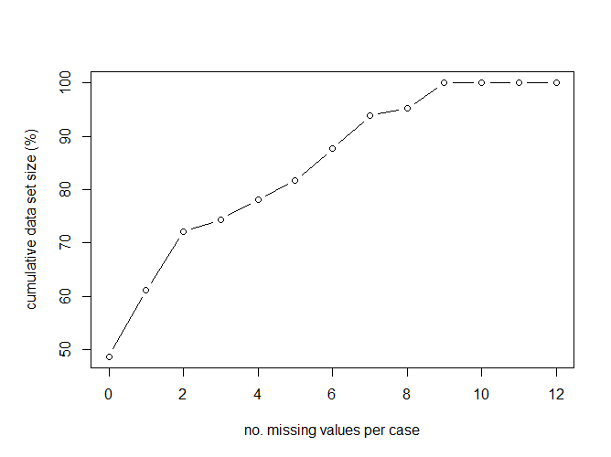
This plot tells what part of the dataset can be used if we allow for no, one, two to 12 missing values per case/patient, that is, 49%, 61%, 72% to 100%, respectively

Slide 56
Imputation (or ignorance)
Multiple and single imputation helps to complete cases with missing values
Beyond the scope of today
We will do a complete case analysis (in a new data frame: CCdata)
And add BMI to the data set
##### COMPLETE CASE ANALYSIS ########
# perform complete case analysis
# remove a case when it contains a missing value
vars <- c ("Dead", "Gender", "Age", "Motiva", "Height", "Weight", "SysBP", "Pulse",
"NTproBNP", "Creatinine", "Hemoglobin", "Glucose", "QoL" )
idx <- which( rowSums(is.na(mydata[,vars])) > 0)
CCdata <- mydata[-idx,]
# Add BMI to the data set
CCdata$BMI <- CCdata$Weight / ( 0.0001 * CCdata$Height * CCdata$Height)
summary(CCdata)

Slide 57
Modelling - Univariate
You need to have sufficient number of events (deaths) to make a robust risk model
Original data set
1,618 deaths amongst 7,488 cases : 22% event rate
RoT: we require at least 10 events per variable/degree of freedom (EPV)
1,618 / 10, that is more than 160 degrees of freedom
We will make risk model consisting at max 11 predictors
Ample room (more than enough data) for modeling; unlikely chance for overfitting
Complete case data set
870 deaths amongst 3,645 cases : 24% event rate
RoT: we require at least 10 events per variable/degree of freedom (EPV)
870 / 10 amounts to 87 degrees of freedom
We will make risk model consisting at max 11 predictors
Sufficient amount of data for modeling with simple predictors

Slide 58
Modelling - Univariate
What is the effect of each predictor to the outcome 1Y-dead?
Compute dot-plot marginal associations (Spearman’s rho) with the outcome dead, by stratifying by quartiles of the candidate predictors
result <- summary(Dead ~ Motiva + Age + Gender + BMI + Pulse + SysBP + QoL,
data = CCdata)
plot ( result, cex.lab = .75, main ="", xlab="P(1Y-dead)")
Findings on predictive power (see next slide):
Being on telehealth (Motiva) reduces ‘’risk of dying’’
The older you are the higher chance of dying
Being female is associated with dead
Being underweight (low BMI) is associated with dead
High pulse (above 80 bpm) is associated with dead
Low blood pressure is associated with with dead
Very low QoL is associated with dead

Slide 59
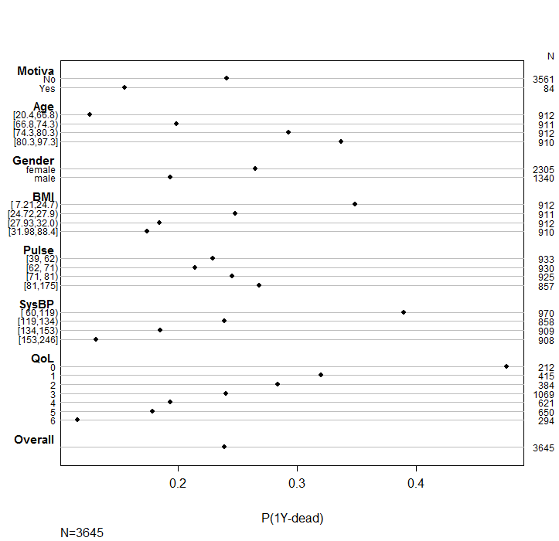

Slide 60
Modelling - Univariate
result <- summary(Dead ~ log10(NTproBNP) + Creatinine + Hemoglobin +
Glucose, data = CCdata )
plot ( result, cex.lab = 0.75, main ="", xlab="P(1Y-dead)" )
Findings on predictive power (see next slide):
High NTproBNP is associated with dead (severe HF)
High Creatinine is associated with dead (kidney failure)
Low Hemoglobin is associated with dead (anemia)
High Creatinine is associated with dead

Slide 61
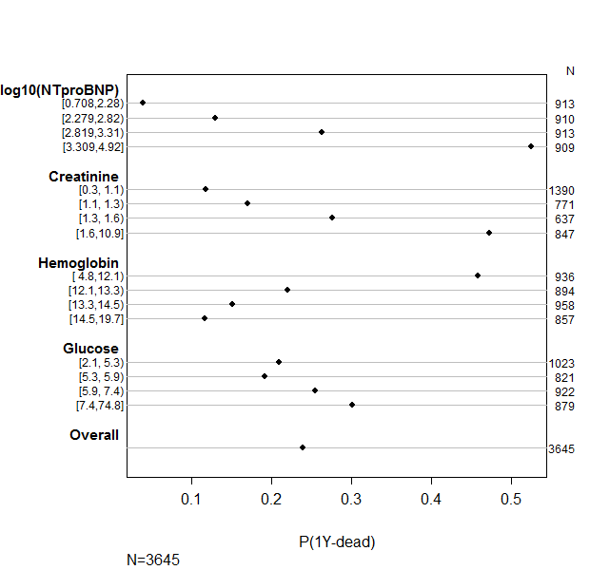

Slide 62
Modelling - Univariate
What is the estimated tendency of a predictor to outcome?
provide guidance in adding predictors to the model
thinking about interaction effects in the model
recommend transformation of predictors (e.g., logarithm, restricted cubic splines, polynomials).

Slide 63
Modeling - Univariate
First, create some ordinal categories for BMI, Creatinine, Glucose and Hemoglobin for stratification
CCdata$BMI.g[CCdata$BMI < 18.5] <- "Underweight"
CCdata$BMI.g[CCdata$BMI >= 18.5 & CCdata$BMI < 25] <- "Normal"
CCdata$BMI.g[CCdata$BMI >= 25 & CCdata$BMI < 30] <- "Overweight"
CCdata$BMI.g[CCdata$BMI >= 30 ] <- "Obese"
CCdata$BMI.g <- ordered (CCdata$BMI.g, levels = c ( "Underweight", "Normal",
"Overweight", "Obese" ))
CCdata$Creatinine.g[CCdata$Creatinine < 1.0] <- "Normal Cr"
CCdata$Creatinine.g[CCdata$Creatinine >= 1.0 & CCdata$Creatinine < 2.0] <- "High Cr"
CCdata$Creatinine.g[CCdata$Creatinine >= 2.0] <- "Very high Cr"
CCdata$Creatinine.g <- ordered (CCdata$Creatinine.g, levels = c ( "Normal Cr",
"High Cr", "Very high Cr" ))
CCdata$Glucose.g[CCdata$Glucose < 8] <- "Normal G"
CCdata$Glucose.g[CCdata$Glucose >= 8] <- "High G"
CCdata$Glucose.g <- ordered (CCdata$Glucose.g, levels = c ( "Normal G", "High G" ))
CCdata$Hemoglobin.g[CCdata$Hemoglobin < 12.1 ] <- "Low Hgb"
CCdata$Hemoglobin.g[CCdata$Hemoglobin >= 12.1 ] <- "Normal Hgb"
CCdata$Hemoglobin.g <- ordered (CCdata$Hemoglobin.g, levels = c ( "Low Hgb",
"Normal Hgb" ))

Slide 64
Modeling - Univariate
Use plsmo function from Hmisc; it displays a smoothed estimated curve of a continuous variable (predictor) and a binary variable (outcome), possibly stratified by other nominal or ordinal variables
The relationship between Age | Gender, blood pressure, BMI and 1Y-dead
par (mfrow = c (2,2) ) # for dividing the window in two by two
plsmo (CCdata$Age, CCdata$Dead, group=CCdata$Gender, datadensity = TRUE,
ylab="P(1Y-dead)", xlab="age(yrs)" )
plsmo (CCdata$SysBP, CCdata$Dead, datadensity = TRUE,
ylab="P(1Y-Dead)", xlab="SysBP(mmHg)" )
plsmo (CCdata$BMI, CCdata$Dead, datadensity = TRUE,
ylab="P(1Y-Dead)", xlab="BMI(cm/kg2)" )
plsmo (CCdata$SysBP, CCdata$Dead, group=CCdata$BMI.g, datadensity = TRUE,
ylab="P(1Y-Dead)", xlab="SysBP(mmHg)" )
Findings (see next slide):
Age is monotonically increasingly and nearly linearly related to the probability of 1Y-dead
Irrespective of age, females have a higher chance of 1Y-dead than males
Blood pressure is monotonically decreasingly related to the probability of 1Y-dead
The condition of being ‘overweight’ or ‘obese’ lowers the probability of dead within one-year. This counter-intuitive observation is described in literature as ‘reverse epidemiology’.

Slide 65
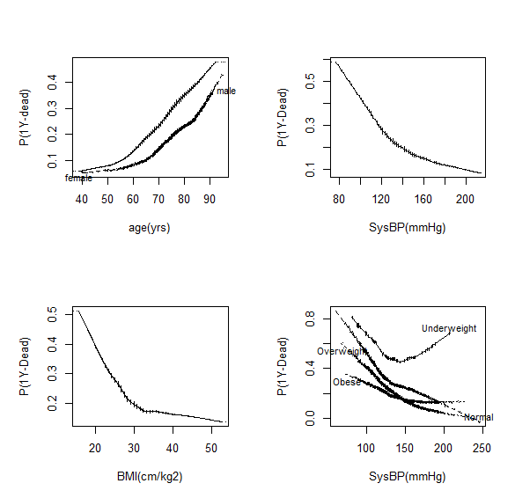

Slide 66
Modeling - Univariate
The relationship between blood markers and 1Y-dead
par (mfrow = c (2,2) ) # for dividing the window in two by two
plsmo (log10(CCdata$NTproBNP), CCdata$Dead, datadensity = TRUE,
ylab="P(1Y-Dead)", xlab="NT-proBNP(log pg/mL)" )
plsmo (CCdata$Creatinine, CCdata$Dead, datadensity = TRUE,
ylab="P(1Y-Dead)", xlab="Creatinine(mg/dL)")
plsmo (CCdata$Glucose, CCdata$Dead, datadensity = TRUE,
ylab="P(1Y-Dead)", xlab="Glucose(mmol/L)")
plsmo (CCdata$Hemoglobin, CCdata$Dead, datadensity = TRUE,
ylab="P(1Y-Dead)", xlab="Hemoglobin(g/dL)")
Findings (see next slide):
The log of NT-proBNP is monotonically increasingly related to the prob of 1Y-dead
Higher Creatinine (> 2 mg/dL) is related to higher probability of 1Y-dead
Higher Glucose (> 8 mmol/L) is related to higher probability of 1Y-dead
Lower Hemoglobin (< 12 g/dL) is related to higher probability of 1Y-dead

Slide 67
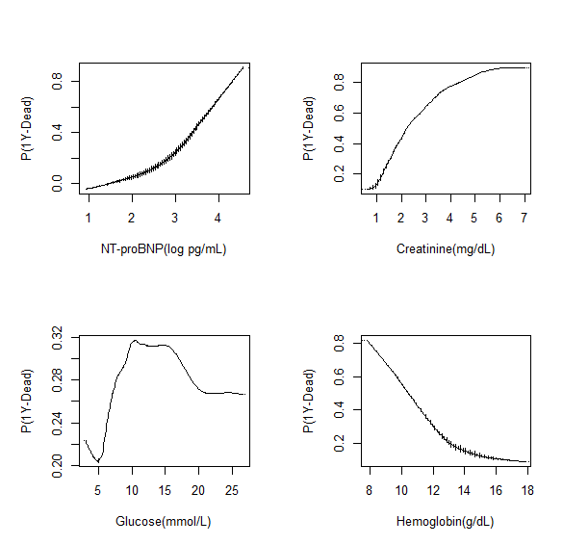

Slide 68
Modeling - Univariate
The relationship between NT-proBNP stratified on levels of Creatinine, Glucose, Hemoglobin, Motiva and 1Y-dead
par (mfrow = c (2,2) ) # for dividing the window in two by two
plsmo (log10(CCdata$NTproBNP), CCdata$Dead, group=CCdata$Creatinine.g,
datadensity = TRUE, ylab="P(1Y-Dead)", xlab="NT-proBNP(log pg/mL)" )
plsmo (log10(CCdata$NTproBNP), CCdata$Dead, group=CCdata$Motiva,
datadensity = TRUE, ylab="P(1Y-Dead)", xlab="NT-proBNP(log pg/mL)" )
plsmo (log10(CCdata$NTproBNP), CCdata$Dead, group=CCdata$Glucose.g,
datadensity = TRUE, ylab="P(1Y-Dead)", xlab="NT-proBNP(log pg/mL)" )
plsmo (log10(CCdata$NTproBNP), CCdata$Dead, group=CCdata$Hemoglobin.g,
datadensity = TRUE, ylab="P(1Y-Dead)", xlab="NT-proBNP(log pg/mL)" )
Findings (see next slide):
Very high Creatinine (> 2 mg/dL) worsens prospect of patient with high NT-proBNP
Telehealth (Motiva) has beneficial impact for patients with high NT-proBNP
High Glucose and Low Hemoglobin has impact

Slide 69
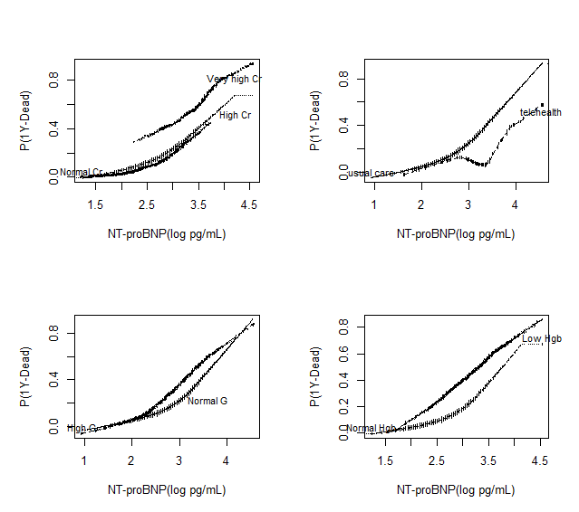

Slide 70
Modelling - Multivariate
Arriving at the final risk model using glm in R
fit <- glm( Dead ~ Age + Gender + (BMI >= 30.0) + SysBP +
(Pulse >= 80.0) + log10(NTproBNP) +
(Creatinine >= 2.0) + (Hemoglobin < 12.0) +
(Glucose >= 8.0) + (QoL == 0) + Motiva,
family=binomial("logit"), data = CCdata )
summary ( fit )
# display regression coefficients - Beta
coefficients ( fit )
# display odds ratios
exp(coefficients (fit))
BMI >= 30 means Obese (Normal range: 18.5 - 25)
Pulse >= 80 bpm refers to heart palpitations, which feel like the heart is racing or throbbing to "make up for" the loss in pumping capacity
Creatinine >= 2.0 refers to the filtering of the kidney is deficient (kidney failure)
Hemoglobin < 12 refers to anemia. Reference ranges for men and women after middle age
are 12.4-14.9 g/dL and 11.7-13.8 g/dL
Glucose >= 8.0 refers to high glucose (pre-)diabetes. Reference range fasting glucose level is 3.6 - 5.8 mmol/L

Slide 71
Modeling - Multivariate
predictor | coefficient | odds ratio | comment
(intercept) | -5.08
Age | 0.015 | 1.20 | per decade
Male | -0.29 | 0.75
SysBP (blood pressure) | -0.015 | 0.86 | per 10 mmHg
Obese (BMI ≥ 30 cm/kg2) | -0.25 | 0.78
Tachycardia (HR ≥ 80 bpm) | 0.23 | 1.25
NT-proBNP level | 1.47 | 4.33 | per log pg/mL
Kidney failure (Cr ≥ 2 mg/dL) | 0.74 | 2.09
Anemia (Hgb < 12.0 g/dL) | 0.80 | 2.23
Diabetes mellitus (glucose ≥ 8 mmol/L) | 0.56 | 1.76
Very poor quality of life (zero-QoL) | 0.60 | 1.82
telehealth | -1.61 | 0.20

Slide 72
Testing and validation
k-fold cross validation with k = 10
Assessing the performance of the risk model
A model is given a dataset of known data on which training is run (training set), and a dataset of unknown data (or first seen data) against which the model is tested (test set)
test set
training set
fold 1
fold 2
fold 3
fold 4
all data

Slide 73
Testing and validation
Cross-validation by using the caret package in R
require(caret)
avg_auc<-0
i<-0
while (i < 10) {
tc <- trainControl("cv", 10, savePred=T) # apply 10 fold cross validation
model <- train( Dead ~ Age + Gender + (BMI >= 30.0) + SysBP + (Pulse >= 80.0) +
log10(NTproBNP) + (Creatinine >= 2.0) + (Hemoglobin < 12.0) +
(Glucose >= 8.0) + (QoL == 0) + Motiva,
data=CCdata, method="glm", trControl=tc, family=binomial)
pred <- prediction(model$pred$pred, model$pred$obs)
auc <- performance(pred, "auc")
auc <- unlist(slot(auc, "y.values"))
print ( paste ("AUC: ", round(100*auc,1), "% "))
avg_auc<-avg_auc+auc
i<- i+1
}
avg_auc<- avg_auc/10
avg_auc

Slide 74
Testing and validation
ROC analysis and performance of the risk model using cut-offs to find optimal decision point
cutoff <- 0.2425
prediction_cv <- cut(model$pred$pred, c(-Inf,cutoff,Inf), labels=c("no","yes"))
a<-table(prediction_cv,model$pred$obs)
perf <- performance(pred,"tpr","fpr")
all<-(a[1,1]+a[1,2]+a[2,1]+a[2,2])
tp<-a[2,2]
tn<-a[1,1]
fp<-a[2,1]
fn<-a[1,2]
ppv <- tp/(tp+fp)
npv <- tn/(tn+fn)
sens <- tp/(tp+fn)
spec <- tn/(tn+fp)
acc <- (tp+tn)/all
prevalence <- (fn+tp)/all
det_rate <- tp/all
det_pr <- (tp+fp)/all
e_acc <- (((tn+fp)*(tn+fn) / all) + ((fn+tp)*(fp+tp) / all)) / all
kappa <- (acc-e_acc)/(1-e_acc)

Slide 75
Testing and validation
cut-off | 0.2425
 | Observed 1Y-dead | Observed 1Y-alive
Predicted 1Y-dead | 664 (tp) | 655 (fp)
Predicted 1Y-alive | 206 (fn) | 2120 (tn)
AUC (c-statistics) | 0.84
Sensitivity | 0.76
Specificity | 0.76
Pos Pred Value (PPV) | 0.50
Neg Pred Value (NPV) | 0.91
Prevalence | 0.24

Slide 76
Testing and validation
cut-off | 0.5
 | Observed 1Y-dead | Observed 1Y-alive
Predicted 1Y-dead | 409 (tp) | 177 (fp)
Predicted 1Y-alive | 461 (fn) | 2598 (tn)
AUC (c-statistics) | 0.84
Sensitivity | 0.47
Specificity | 0.94
Pos Pred Value (PPV) | 0.7
Neg Pred Value (NPV) | 0.85
Prevalence | 0.24

Slide 77
Testing and validation
cut-off | 0.1
 | Observed 1Y-dead | Observed 1Y-alive
Predicted 1Y-dead | 800 (tp) | 1424 (fp)
Predicted 1Y-alive | 70 (fn) | 1351 (tn)
AUC (c-statistics) | 0.84
Sensitivity | 0.92
Specificity | 0.49
Pos Pred Value (PPV) | 0.36
Neg Pred Value (NPV) | 0.95
Prevalence | 0.24

Slide 78
Testing and validation
ROC curve plotting
Use packages pROC and ROCR in R
## Plot ROC curve
roc0 <- roc(model$pred$obs, model$pred$pred)
plot(roc0, print.thres = c(0.1, 0.2425, 0.5), type = "S",
col="green",lwd=2, main="ROC Curve",
print.thres.pattern = "%.3f (Spec = %.2f, \n Sens = %.2f)",
print.thres.cex = .8, legacy.axes = TRUE)

Slide 79
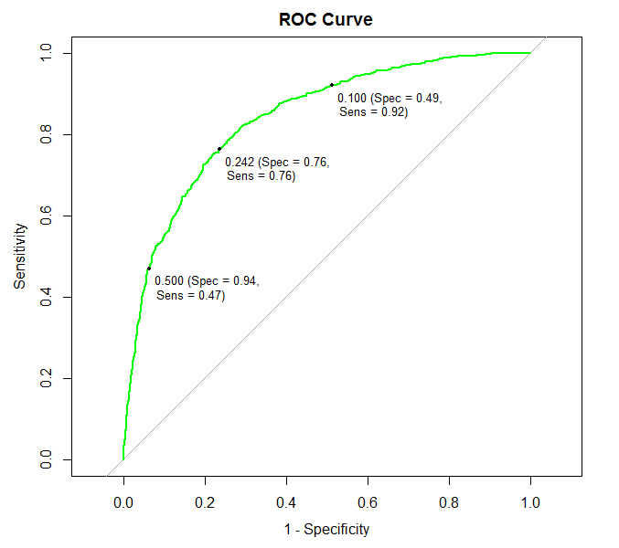
AUC = 0.84

Slide 80
Clinical (external) validation
Is the risk model useful for clinical decision making?
Setting optimal cut-off using harm-benefit analysis
Risk model need to be calibrated to cohort/setting at hand
Clinical expertise and input required
Design intervention for which risk model will be used
Collect new data to (externally) validate risk model
Conduct clinical pilot to test risk model in practice
Conduct risk-stratified intervention pilot to test combination risk model and intervention

